Slide 1

CSE- 321
Software Engineering
Lecture : 17 Software Verification & Validation , Testing
Fahad Ahmed
Lecturer, Dept. of CSE
E-mail: fahadahmed@uap-bd.edu

Slide 2
B | A
29 March | 1 April | Testing-1
5 April | 6 April | Testing-2
7 April | 8 April | Maintenance+ Deployment + Security
12 April | 13 April | ct-4 (Testing + Cost)
After 8-13 |  | Final Viva
*Assignment-03- Quality Assurance + Testing
** Final viva: Design, Testing, Security

Slide 3
Lecture Outlines
Verification and Validation
Cleanroom software development
Software testing
Software testing types
Black-box Testing ,White-box Testing, Grey-Box Testing

Slide 4


Verification and Validation

Slide 5

Verification and Validation
Verification: "Are we building the product right”.
The software should conform to its specification.
Validation: "Are we building the right product”.
The software should do what the user really requires.

Slide 6
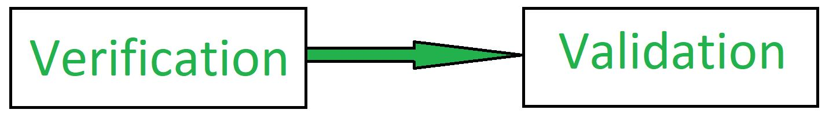
Verification and Validation (V & V)
Verification: Verification is the process of checking that a software achieves its goal without any bugs. It is the process to ensure whether the product that is developed is right or not. It verifies whether the developed product fulfills the requirements that we have.
Activities involved in verification: Inspections Reviews, Walkthroughs, Desk-checking
Validation: Validation is the process of checking whether the software product is up to the mark or in other words product has high level requirements. It is the process of checking the validation of product , it checks what we are developing is the right product. it is validation of actual and expected product.
Includes program reviews, system testing, customer acceptance testing.

Slide 7
The V & V process
Is a whole life-cycle process - V & V must be applied at each stage in the software process.
Has two principal objectives
The discovery of defects in a system;
The assessment of whether or not the system is useful and useable in an operational situation.
V & V goals
Verification and validation should establish confidence that the software is fit for purpose.
This does NOT mean completely free of defects.
Rather, it must be good enough for its intended use and the type of use will determine the degree of confidence that is needed.

Slide 8
V and V Techniques
Techniques
Static Methods
Dynamic Methods
Techniques applied to artifacts through execution.
Testing
Techniques applied to artifacts without execution.
Inspections and Reviews
Notes:
Static Methods
Reviews
Walkthroughs
Inspections
Program Reviews Dynamic Methods
Testing

Slide 9
Static and dynamic verification
Software inspections is a static V & V process in which a software system is reviewed to find errors, omissions and anomalies. Generally, inspections focus on source code, but any readable representation of the software such as its requirements or a design model can be inspected.
May be supplement by tool-based document and code analysis
Inspections do not require execution of a system so may be used before implementation.
They may be applied to any representation of the system such as the requirements or design.
They have been shown to be an effective technique for discovering program errors.

Slide 10
Static and dynamic verification
Software inspections
Inspections are an old idea. There have been several studies and experiments that have demonstrated that inspections are more effective for defect discovery than program testing.
Fagan (Fagan, 1986) reported that more than 60% of the errors in a program can be detected using informal program inspections.
Mills et al. (Mills, et al., 1987) suggest that a more formal approach to inspection based on correctness arguments can detect more than 90% of the errors in a program.

Slide 11
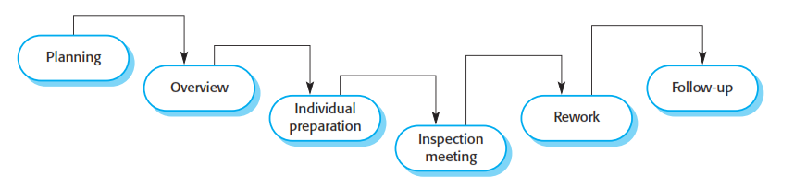
The inspection process
System overview presented to inspection team.
Code and associated documents are distributed to inspection team in advance for individual preparation.
Inspection meeting takes place and discovered errors are noted.
Modifications are made to repair discovered errors (by owner).
Re-inspection may or may not be required.

Slide 12
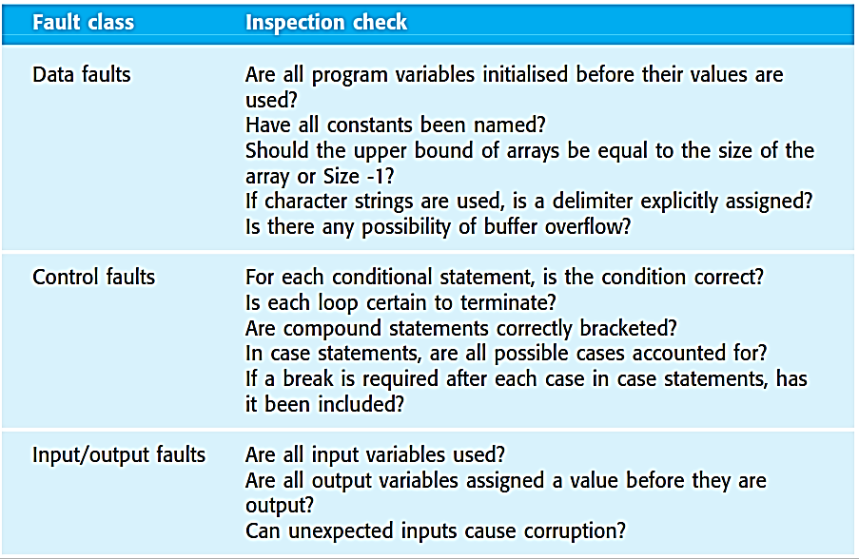
Inspection Checks
Possible checks that might be made during the inspection process

Slide 13
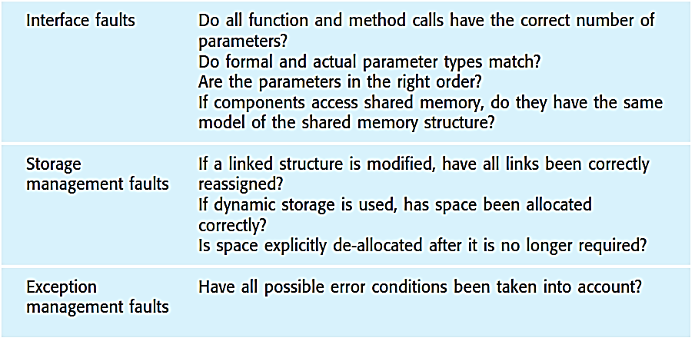
Inspection Checks
Possible checks that might be made during the inspection process

Slide 14
Static and dynamic verification
Software testing Concerned with exercising and observing product behaviour (dynamic verification)
Inspections and testing are complementary and not opposing verification techniques. Both should be used during the V & V process.
Inspections can check conformance with a specification but not conformance with the customer's real requirements. Inspections cannot check non-functional characteristics such as performance, usability, etc.
Software testing is a process of identifying the correctness of software by considering its all attributes (Reliability, Scalability, Portability, Re-usability, Usability) and evaluating the execution of software components to find the software bugs or errors or defects.

Slide 15
Program testing
Can reveal the presence of errors NOT their absence.
The only validation technique for non-functional requirements as the software has to be executed to see how it behaves.
Should be used in conjunction with static verification to provide full V&V coverage
Typically, a commercial software system has to go through three stages of testing:
Development testing: the system is tested during development to discover bugs and defects.
Release testing: a separate testing team test a complete version of the system before it is released to users.
User testing: users or potential users of a system test the system in their own environment.

Slide 16
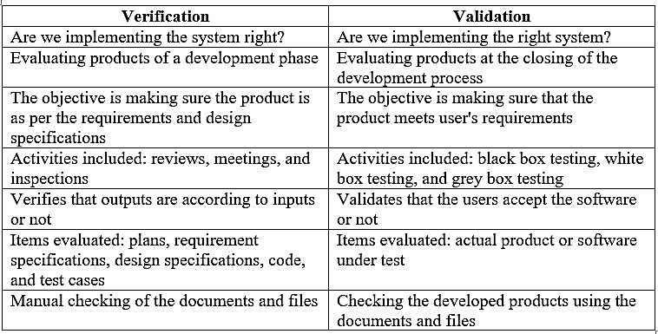
Verification vs Validation

Slide 17
Verification vs Validation
VERIFICATION | VALIDATION
Verification is the static testing. | Validation is the dynamic testing.
It does not include the execution of the code. | It includes the execution of the code.
Methods used in verification are reviews, walkthroughs, inspections and desk-checking. | Methods used in validation are Black Box Testing, White Box Testing and non-functional testing.
It checks whether the software conforms to specifications or not. | It checks whether the software meets the requirements and expectations of a customer or not.
It can find the bugs in the early stage of the development. | It can only find the bugs that could not be found by the verification process.
The goal of verification is application and software architecture and specification. | The goal of validation is an actual product.
Quality assurance team does verification. | Validation is executed on software code with the help of testing team.
It comes before validation. | It comes after verification.
It consists of checking of documents/files and is performed by human. | It consists of execution of program and is performed by computer.

Slide 18
Cleanroom software development
The name is derived from the “Cleanroom” process in semiconductor fabrication.
The philosophy is defect avoidance rather than defect removal.
Cleanroom software development (Mills, et al., 1987; Cobb and Mills, 1990; Linger, 1994; Prowell, et al., 1999) is a software development philosophy that uses formal methods to support rigorous software inspection.
A software development process based on:
Incremental development (if appropriate)
Formal specification
Static verification using correctness arguments
Statistical testing to certify program reliability

Slide 19
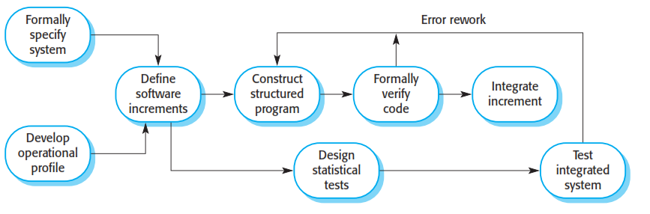
The Cleanroom process
The objective of this approach to software development is zero-defect software.

Slide 20
The Cleanroom process
The Cleanroom approach to software development is based on five key strategies:
1. Formal specification The software to be developed is formally specified. A state transition model that shows system responses to stimuli is used to express the specification.
2. Incremental development The software is partitioned into increments that are developed and validated separately using the Cleanroom process. These increments are specified, with customer input, at an early stage in the process.
3. Structured programming Only a limited number of control and data abstraction constructs are used. The program development process is a process of stepwise refinement of the specification. A limited number of constructs are used and the aim is to systematically transform the specification to create the program code.

Slide 21
The Cleanroom process
4. Static verification The developed software is statically verified using rigorous software inspections. There is no unit or module testing process for code components.
5. Statistical testing of the system The integrated software increment is tested statistically, to determine its reliability. These statistical tests are based on an operational profile, which is developed in parallel With the system specification.

Slide 22
Software testing

Slide 23
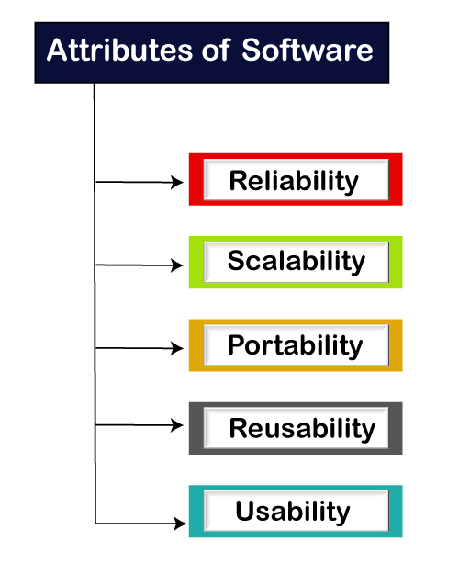

Software testing
Software testing is a process of identifying the correctness of software by considering its all attributes (Reliability, Scalability, Portability, Re-usability, Usability) and evaluating the execution of software components to find the software bugs or errors or defects.

Slide 24
Software testing
Software testing is a method to check whether the actual software product matches expected requirements and to ensure that software product is defect free.
Software Testing Definition according to ANSI/IEEE 1059 standard – A process of analyzing a software item to detect the differences between existing and required conditions (i.e., defects) and to evaluate the features of the software item.
Testing can only show the presence of errors in a program. It cannot demonstrate that there are no remaining faults.

Slide 25


Software testing terms
Fault
Failure
Defect
Error

Slide 26
Software testing terms
Error:
Error is deviation from actual and expected value.
It represents mistake made by people.
Fault
Fault is incorrect step, process or data definition in a computer program which causes the program to behave in an unintended or unanticipated manner.
It is the result of the error.
Bug
Bug is a fault in the program which causes the program to behave in an unintended or unanticipated manner.
It is an evidence of fault in the program.
Failure
Failure is the inability of a system or a component to perform its required functions within specified performance requirements.
Failure occurs when fault executes.
Defect
A defect is an error in coding or logic that causes a program to malfunction or to produce incorrect/unexpected results.
A defect is said to be detected when a failure is observed.

Slide 27
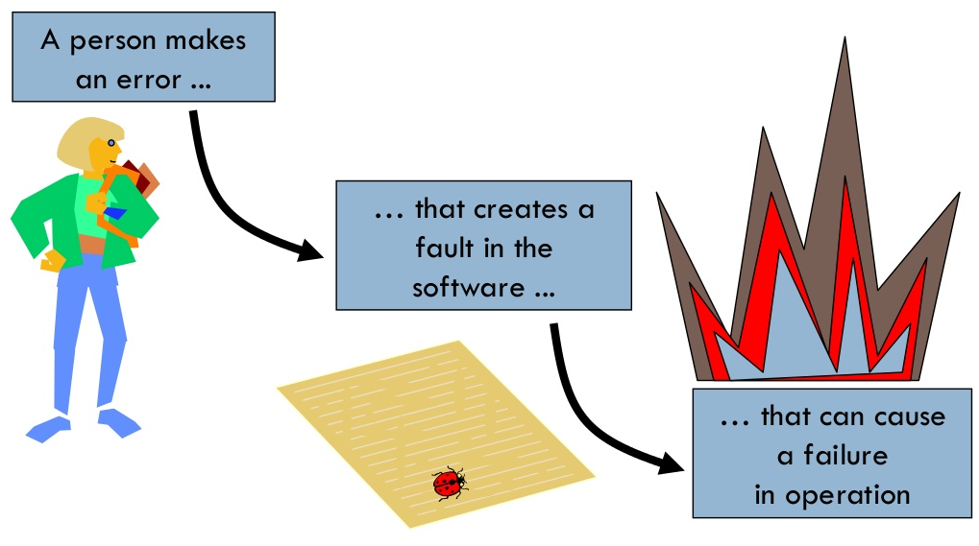
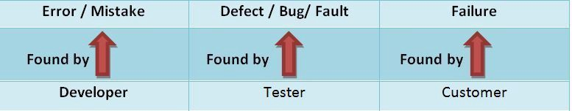
Software testing terms

Slide 28
Benefits of Software Testing
What are the benefits of Software Testing?
Cost-Effective: It is one of the important advantages of software testing. Testing any IT project on time helps you to save your money for the long term. In case if the bugs caught in the earlier stage of software testing, it costs less to fix.
Security: It is the most vulnerable and sensitive benefit of software testing. People are looking for trusted products. It helps in removing risks and problems earlier.
Product quality: It is an essential requirement of any software product. Testing ensures a quality product is delivered to customers.
Customer Satisfaction: The main aim of any product is to give satisfaction to their customers. UI/UX Testing ensures the best user experience.

Slide 29
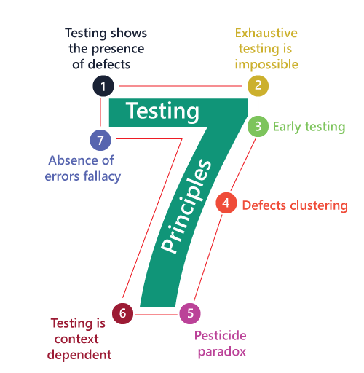
Software Testing Principles

Slide 30
Software Testing Principles
Testing shows presence of defects:
The goal of software testing is to make the software fail. Software testing reduces the presence of defects. Software testing talks about the presence of defects and doesn’t talk about the absence of defects. Software testing can ensure that defects are present but it can not prove that software is defects free. Even multiple testing can never ensure that software is 100% bug-free. Testing can reduce the number of defects but not removes all defects.
Exhaustive testing is not possible:
It is the process of testing the functionality of a software in all possible inputs (valid or invalid) and pre-conditions is known as exhaustive testing. Exhaustive testing is impossible means the software can never test at every test cases. It can test only some test cases and assume that software is correct and it will produce the correct output in every test cases. If the software will test every test cases then it will take more cost, effort, etc. and which is impractical.
Early Testing:
To find the defect in the software, early test activity shall be started. The defect detected in early phases of SDLC will very less expensive. For better performance of software, software testing will start at initial phase i.e. testing will perform at the requirement analysis phase.

Slide 31
Software Testing Principles
Defect clustering:
In a project, a small number of the module can contain most of the defects. Pareto Principle to software testing state that 80% of software defect comes from 20% of modules.
Pesticide paradox:
Repeating the same test cases again and again will not find new bugs. So it is necessary to review the test cases and add or update test cases to find new bugs.
Testing is context dependent:
Testing approach depends on context of software developed. Different types of software need to perform different types of testing. For example, The testing of the e-commerce site is different from the testing of the Android application.
Absence of errors fallacy:
If a built software is 99% bug-free but it does not follow the user requirement then it is unusable. It is not only necessary that software is 99% bug-free but it also mandatory to fulfill all the customer requirements.

Slide 32
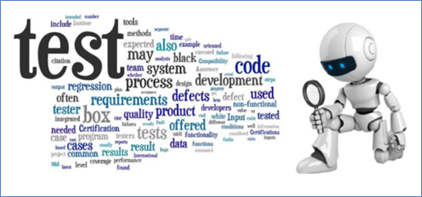
Testing Guidelines
Development team should avoid testing the software
Testing must be done with unexpected and negative inputs
Software can never be 100% bug-free after making a number of test cases
Start as early as possible
The time available is limited
Inspecting test results properly
Validating assumptions
https://www.geeksforgeeks.org/software-engineering-testing-guidelines/

Slide 33
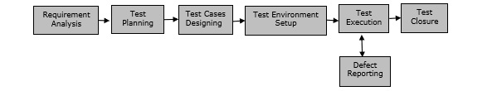
Software Testing Life Cycle
STLC stands for Software Testing Life Cycle. STLC is a sequence of different activities performed by the testing team to ensure the quality of the software or the product.
STLC is an integral part of Software Development Life Cycle (SDLC). But, STLC deals only with the testing phases.
STLC starts as soon as requirements are defined or SRD (Software Requirement Document) is shared by stakeholders.
STLC provides a step-by-step process to ensure quality software.

Slide 34
Software Testing Life Cycle
There are 6 major phases of STLC −
Requirement Analysis − When the SRD is ready and shared with the stakeholders, the testing team starts high level analysis concerning the AUT (Application under Test).
Test Planning − Test Team plans the strategy and approach.
Test Case Designing/Developing − Develop the test cases based on scope and criteria’s.
Test Environment Setup − When integrated environment is ready to validate the product.
Test Execution − Real-time validation of product and finding bugs.
Test Closure − Once testing is completed, matrix, reports, results are documented.

Slide 35
Testing process
Component testing
Testing of individual program components;
Usually the responsibility of the component developer (except sometimes for critical systems);
Tests are derived from the developer’s experience.
System testing
Testing of groups of components integrated to create a system or sub-system;
The responsibility of an independent testing team;
Tests are based on a system specification

Slide 36
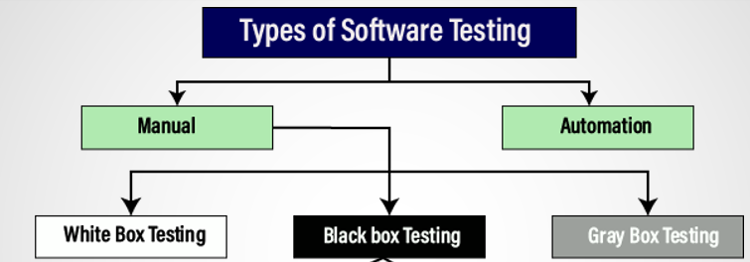
Software Testing

Slide 37
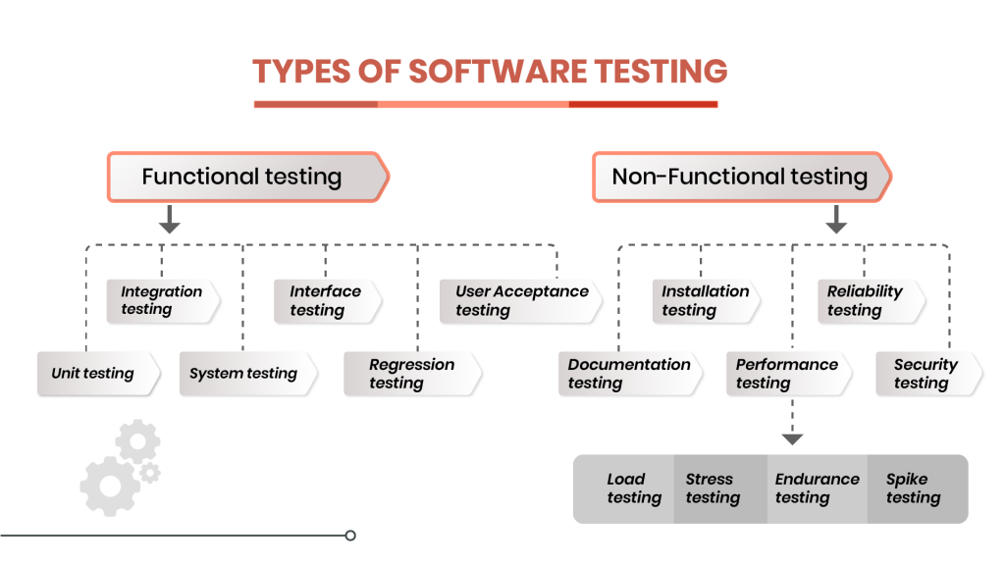
Software Testing

Slide 38
Manual testing
Manual testing
The process of checking the functionality of an application as per the customer needs without taking any help of automation tools is known as manual testing.
While performing the manual testing on any application, we do not need any specific knowledge of any testing tool, rather than have a proper understanding of the product so we can easily prepare the test document.
Manual testing can be further divided into three types of testing, which are as follows:
White box testing
Black box testing
Gray box testing

Slide 39
Manual testing
Advantages of Manual Testing
It does not require programming knowledge while using the Black box method.
It is used to test dynamically changing GUI designs.
Tester interacts with software as a real user so that they are able to discover usability and user interface issues.
It is cost-effective.
Easy to learn for new testers.
Disadvantages of Manual Testing
It requires a large number of human resources.
It is very time-consuming.
Tester develops test cases based on their skills and experience. There is no evidence that they have covered all functions or not.
Test cases cannot be used again. Need to develop separate test cases for each new software.
It does not provide testing on all aspects of testing.
Since two teams work together, sometimes it is difficult to understand each other's motives, it can mislead the process.

Slide 40
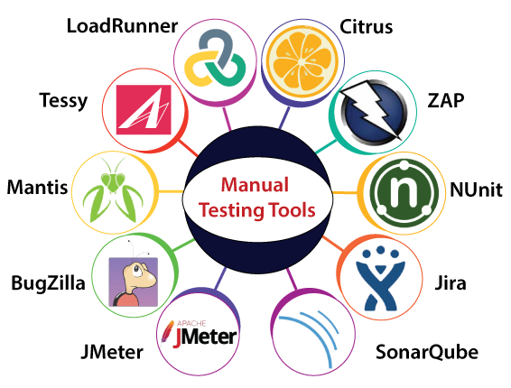
Manual testing tools

Slide 41
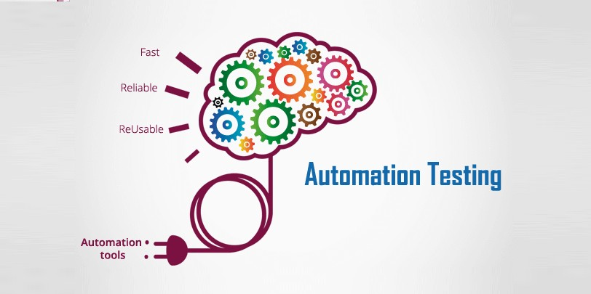
Automation testing
Automation testing is a process of converting any manual test cases into the test scripts with the help of automation tools, or any programming language is known as automation testing.

Slide 42
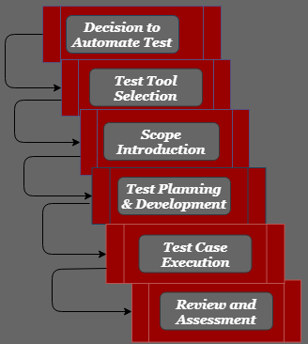
Life cycle of Automation Testing

Slide 43
Automation Testing
Advantages of Automation Testing
Automation testing takes less time than manual testing.
Automation Testing provides re-usability of test cases on testing of different versions of the same software.
Automation testing is reliable as it eliminates hidden errors by executing test cases again in the same way.
It does not require many human resources, instead of writing test cases and testing them manually, they need an automation testing engineer to run them.
Disadvantages of Automation Testing
Automation Testing requires high-level skilled testers.
It requires high-quality testing tools.
When it encounters an unsuccessful test case, the analysis of the whole event is complicated.
Test maintenance is expensive because high fee license testing equipment is necessary.
Debugging is mandatory if a less effective error has not been solved, it can lead to fatal results.

Slide 44
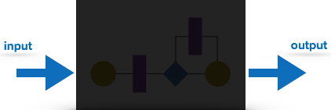
Black box testing
Black box Testing
Black box testing is a technique of software testing which examines the functionality of software without peering into its internal structure or coding.
Black box testing is a method of software testing that examines the functionality of an application
This method of test can be applied to virtually every level of software
The tester is oblivious to the system architecture and does not have access to the source code

Slide 45
Black box testing
Generic steps of black box testing
The black box test is based on the specification of requirements, so it is examined in the beginning.
In the second step, the tester creates a positive test scenario and an adverse test scenario by selecting valid and invalid input values to check that the software is processing them correctly or incorrectly.
In the third step, the tester develops various test cases such as decision table, all pairs test, equivalent division, error estimation, cause-effect graph, etc.
The fourth phase includes the execution of all test cases.
In the fifth step, the tester compares the expected output against the actual output.
In the sixth and final step, if there is any flaw in the software, then it is cured and tested again.

Slide 46
Black box testing
Black-box testing techniques:
Decision Table Technique | Decision Table Technique is a systematic approach where various input combinations and their respective system behavior are captured in a tabular form. It is appropriate for the functions that have a logical relationship between two and more than two inputs.
Boundary Value Technique | Boundary Value Technique is used to test boundary values, boundary values are those that contain the upper and lower limit of a variable. It tests, while entering boundary value whether the software is producing correct output or not.
State Transition Technique | State Transition Technique is used to capture the behavior of the software application when different input values are given to the same function. This applies to those types of applications that provide the specific number of attempts to access the application.
All-pair Testing Technique | All-pair testing Technique is used to test all the possible discrete combinations of values. This combinational method is used for testing the application that uses checkbox input, radio button input, list box, text box, etc.

Slide 47
Black box testing
Black-box testing techniques:
Cause-Effect Technique | Cause-Effect Technique underlines the relationship between a given result and all the factors affecting the result.It is based on a collection of requirements.
Equivalence Partitioning Technique | Equivalence partitioning is a technique of software testing in which input data divided into partitions of valid and invalid values, and it is mandatory that all partitions must exhibit the same behavior.
Error Guessing Technique | Error guessing is a technique in which there is no specific method for identifying the error. It is based on the experience of the test analyst, where the tester uses the experience to guess the problematic areas of the software.
Use Case Technique | Use case Technique used to identify the test cases from the beginning to the end of the system as per the usage of the system. By using this technique, the test team creates a test scenario that can exercise the entire software based on the functionality of each function from start to end.

Slide 48
Black box testing
Advantages of Black Box Testing – Tester can be non-technical. – Used to verify contradictions in actual system and the specifications. – Test cases can be designed as soon as the functional specifications are complete
Disadvantages of Black Box Testing – The test inputs needs to be from large sample space. – It is difficult to identify all possible inputs in limited testing time. So writing test cases is slow and difficult – Chances of having unidentified paths during this testing

Slide 49
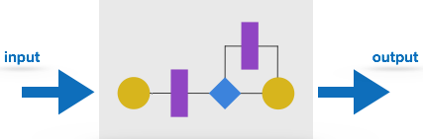
White Box Testing
White box testing is a method of testing software that tests internal structures or working of an application
In white-box testing an internal perspective of the system , as well as programming skills, are used to design test cases
It is also known as clear box testing, glass box testing, transparent box testing, and structural testing
White box testing is the detailed investigation of internal logic and structure of the code
In order to perform white box testing of an application , the tester needs to possess knowledge of the internal working of the code

Slide 50
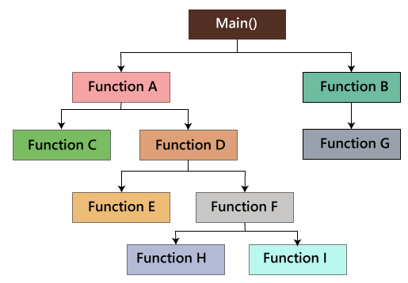
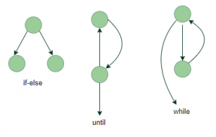
White Box Testing
White Box Testing techniques:
The white box testing contains various parts, which are as follows:
Statement coverage
Testing based on the memory (size) perspective
Condition testing : Multiple Condition Coverage
Basis Path test
Flow graph notation
Loop Testing
https://www.geeksforgeeks.org/software-engineering-white-box-testing/?ref=lbp

Slide 51
White Box Testing
Advantages:
White box testing is very thorough as the entire code and structures are tested.
It results in the optimization of code removing error and helps in removing extra lines of code.
It can start at an earlier stage as it doesn’t require any interface as in case of black box testing.
Easy to automate.
Disadvantages:
Main disadvantage is that it is very expensive.
Redesign of code and rewriting code needs test cases to be written again.
Testers are required to have in-depth knowledge of the code and programming language as opposed to black box testing.
Missing functionalities cannot be detected as the code that exists is tested.
Very complex and at times not realistic.

Slide 52
Black Box Testing vs White Box Testing
BLACK BOX TESTING | WHITE BOX TESTING
It is a way of software testing in which the internal structure or the program or the code is hidden and nothing is known about it. | It is a way of testing the software in which the tester has knowledge about the internal structure r the code or the program of the software.
It is mostly done by software testers. | It is mostly done by software developers.
No knowledge of implementation is needed. | Knowledge of implementation is required.
It can be referred as outer or external software testing. | It is the inner or the internal software testing.
It is functional test of the software. | It is structural test of the software.
This testing can be initiated on the basis of requirement specifications document. | This type of testing of software is started after detail design document.

Slide 53
Black Box Testing vs White Box Testing (cont.)
BLACK BOX TESTING | WHITE BOX TESTING
No knowledge of programming is required. | It is mandatory to have knowledge of programming.
It is the behavior testing of the software. | It is the logic testing of the software.
It is applicable to the higher levels of testing of software. | It is generally applicable to the lower levels of software testing.
It is also called closed testing. | It is also called as clear box testing.
It is least time consuming. | It is most time consuming.
It is not suitable or preferred for algorithm testing. | It is suitable for algorithm testing.
Can be done by trial and error ways and methods. | Data domains along with inner or internal boundaries can be better tested.

Slide 54
GreyBox Testing
Grey-box testing is a software testing method to test the software application with partial knowledge of the internal working structure.
It is a combination of black box and white box testing because it involves access to internal coding to design test cases as white box testing and testing practices are done at functionality level as black box testing.

Slide 55
GreyBox Testing
Why GreyBox testing?

Slide 56
GreyBox Testing
Why GreyBox testing?
Reasons for GreyBox testing are as follows
It provides combined benefits of both Blackbox testing and WhiteBox testing.
It includes the input values of both developers and testers at the same time to improve the overall quality of the product.
It reduces time consumption of long process of functional and non-functional testing.
It gives sufficient time to the developer to fix the product defects.
It includes user point of view rather than designer or tester point of view.
It involves examination of requirements and determination of specifications by user point of view deeply.

Slide 57
GreyBox Testing
Gray Box Testing Techniques:
Matrix Testing
Pattern Testing
Orthogonal Array Testing
Regression Testing
https://www.geeksforgeeks.org/gray-box-testing-software-testing/?ref=rp

Slide 58
GreyBox Testing
Advantages of Gray Box Testing:
Gray box testing is mostly done by the user perspective.
Testers are not required to have high programming skills for this testing.
In gray box testing, developers have more time for defect fixing.
By doing gray box testing, benefits of both black box and white box testing is obtained.
Gray box testing is unbiased. It avoids conflicts between a tester and a developer.
Disadvantages of gray box testing:
Defect association is difficult when gray testing is performed for distributed systems.
Limited access to internal structure leads to limited access for code path traversal.
Because source code cannot be accessed, doing complete white box testing is not possible.
Gray box testing is not suitable for algorithm testing.
https://www.geeksforgeeks.org/gray-box-testing-software-testing/?ref=rp

Slide 59
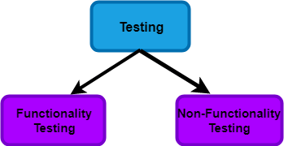
Testing Approaches

Slide 60
Testing Approaches
Functional Testing:
It is a type of software testing which is used to verify the functionality of the software application, whether the function is working according to the requirement specification.
Tester does verification of the requirement specification in the software application.
After analysis, the requirement specification tester will make a plan.
After planning the tests, the tester will design the test case.
After designing the test, case tester will make a document of the traceability matrix.
The tester will execute the test case design.
Analysis of the coverage to examine the covered testing area of the application.
Defect management should do to manage defect resolving.

Slide 61
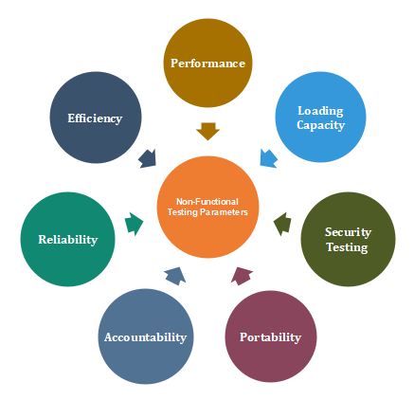
Testing Approaches
Non-Functional Testing
Non-functional testing is a type of software testing to test non-functional parameters such as reliability, load test, performance and accountability of the software. The primary purpose of non-functional testing is to test the reading speed of the software system as per non-functional parameters.

Slide 62
Software Testing

Slide 63
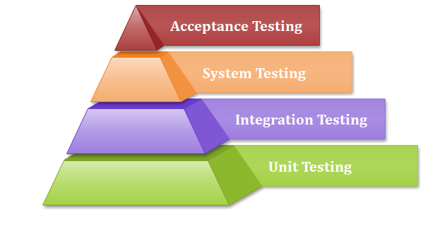
Unit Testing
Unit testing is a type of software testing, where the individual unit or component of the software tested. Unit testing, examine the different part of the application, by unit testing functional testing also done, because unit testing ensures each module is working correctly.
The developer does unit testing. Unit testing is done in the development phase of the application.
Unit Testing Tools
NUnit
JUnit
PHPunit
Parasoft Jtest
EMMA

Slide 64
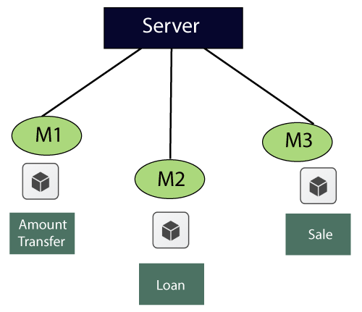
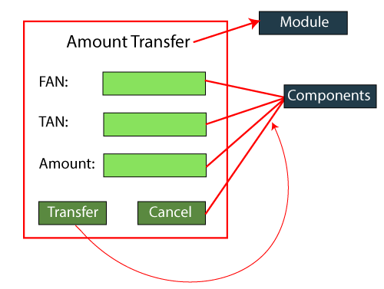
Unit Testing
Unit Testing Techniques:
Unit testing uses all white box testing techniques as it uses the code of software application:
Data flow Testing
Control Flow Testing
Branch Coverage Testing
Statement Coverage Testing
Decision Coverage Testing

Slide 65
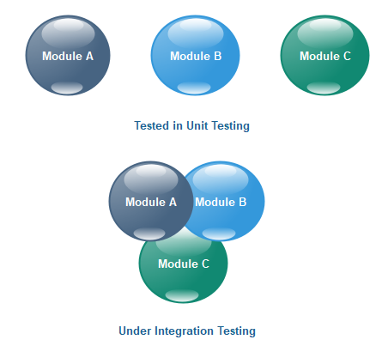
Integration testing
Integration testing
Integration testing is the second level of the software testing process comes after unit testing. In this testing, units or individual components of the software are tested in a group. The focus of the integration testing level is to expose defects at the time of interaction between integrated components or units.

Slide 66
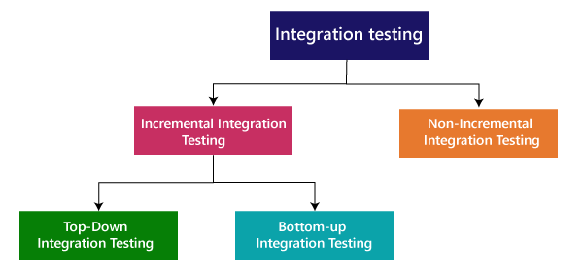
Integration testing
Types of Integration Testing
https://www.javatpoint.com/integration-testing

Slide 67
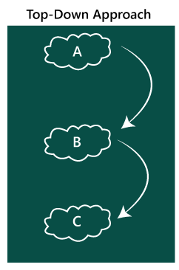
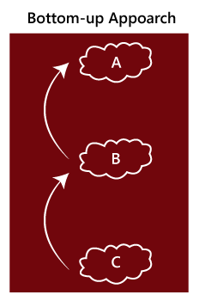
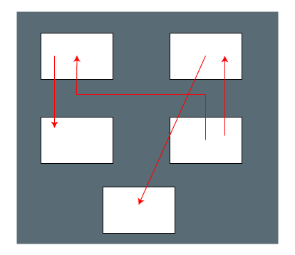
Integration testing
Non- incremental

Slide 68
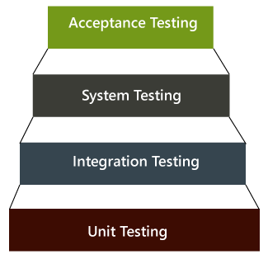
System Testing
System Testing
The software is compiled as product and then it is tested as a whole. This can be accomplished using one or more of the following tests:
Functionality testing - Tests all functionalities of the software against the requirement.
Performance testing - This test proves how efficient the software is. It tests the effectiveness and average time taken by the software to do desired task. Performance testing is done by means of load testing and stress testing where the software is put under high user and data load under various environment conditions.
Security & Portability - These tests are done when the software is meant to work on various platforms and accessed by number of persons.

Slide 69
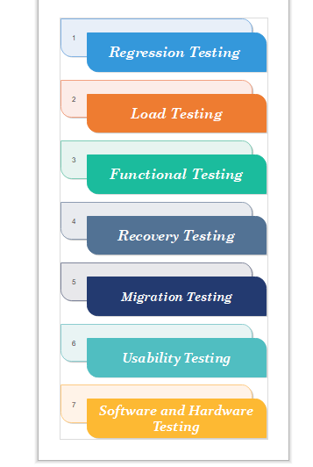
System Testing
System Testing
The software is compiled as product and then it is tested as a whole.
System Testing includes testing of a fully integrated software system.
System testing is divided into more than 50 types.

Slide 70
Acceptance Testing : User testing
Acceptance Testing
When the software is ready to hand over to the customer it has to go through last phase of testing where it is tested for user-interaction and response. This is important because even if the software matches all user requirements and if user does not like the way it appears or works, it may be rejected.
Alpha testing - The team of developer themselves perform alpha testing by using the system as if it is being used in work environment. They try to find out how user would react to some action in software and how the system should respond to inputs.
Beta testing - After the software is tested internally, it is handed over to the users to use it under their production environment only for testing purpose. This is not as yet the delivered product. Developers expect that users at this stage will bring minute problems, which were skipped to attend.

Slide 71

Thanks to All

